Slide 1

Automated Grass cutter
Dr: Nora Niazy
Eng: Ahmed Hany

Slide 2
Team members:
Essam Ali Abdo (Team Leader)
Ebrahim Mohamed Hassan
Alaa El-diin Mohamed
Khaled Mohamed Abo hashim

Slide 3

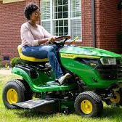
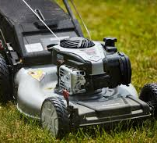
Why do we need an automated grass cutter ?
Grass cutter machine become very popular today. This machine is commonly used to tidy up the garden and to clear the fields from grass or other types of herbs.
As it requires human power to control it and powered by gasoline, we will face the problem of air pollution In addition the energy crisis that hit our world , using the traditional grass cutter will not be efficient anymore.
In our project we will try to over come all this problems by providing an automated grass cutter that’s remotely controlled and powered by electricity to reduce human effort and air pollution.

Slide 4
Project idea:
An automated grass cutter that is powered by solar energy. It handles the grass level and measure soil moisture level for irrigation process.
We use solar panel so there is no need to charge its battery externally.
A mobile application connected through wi-fi is used for controlling the model and all the measurements taken are displayed on the application for the user to see.

Slide 5
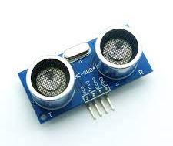
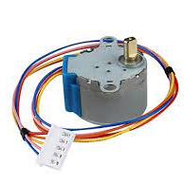
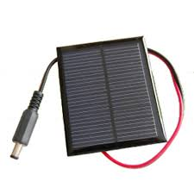
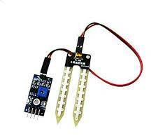
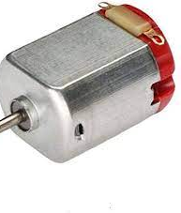
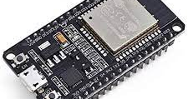
Tools Used:
Mobile application:-
F
MySQL database
Embedded system:-
programming language : “C ”
Hardware:-
ESP32
soil moisture sensor
dc motor
stepper motor
solar energy plate
ultrasonic sensor
GPS module

Slide 6
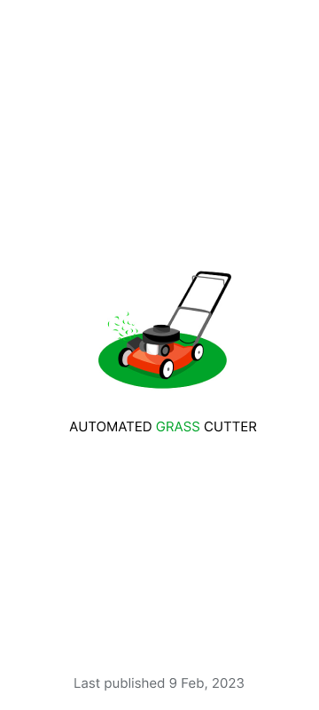
Mobile app screens

Slide 7
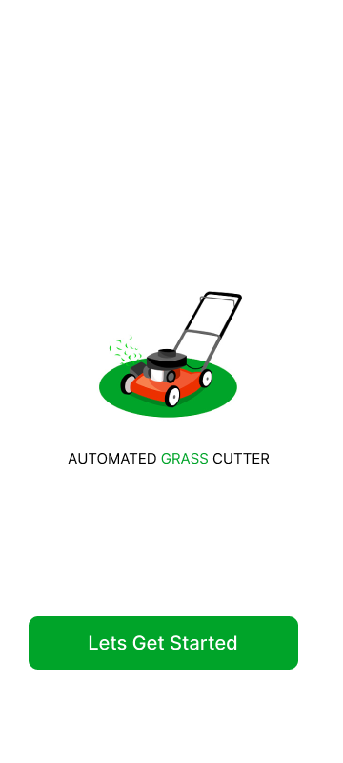



On boarding screens

Slide 8

Safety screen

Slide 9

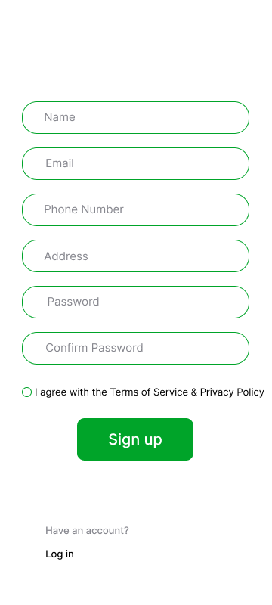
Login & Registration screens

Slide 10


Home screen

Slide 11

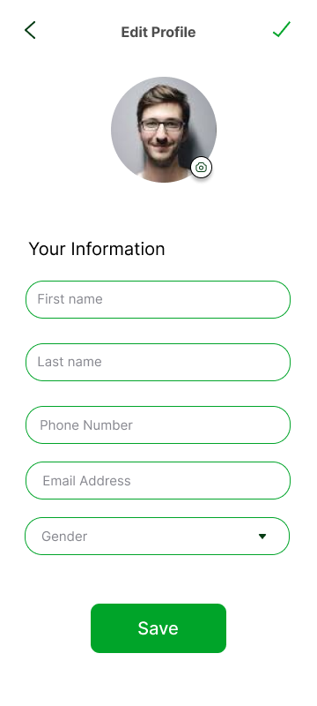
Profile & Edit profile screens

Slide 12
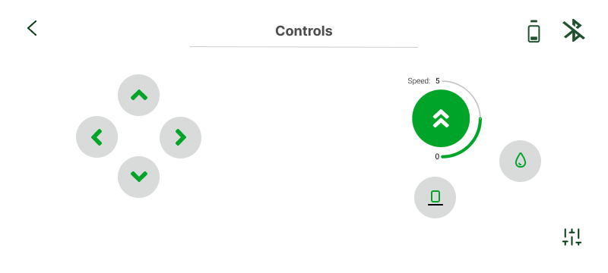
Controls screen

Slide 13

Readings screen

Slide 14

Reset password screen

Slide 15

Settings screen

Slide 16

Feedback screen

Slide 17


